Slide 1
An Exploratory Data Analysis on Food Desert in the USA
DATAS6101 – Intro to Data Science Project
Source: ers.usda.gov
Abishek Chiffon | Keerthana Aravindhan | Mowzli Sre Mohan Dass | Robert Williams

Slide 2
Food Desert
A Food desert is a geographic area, typically in urban or rural regions, where residents have limited access to affordable and nutritious food. In these areas, there is often an absence of grocery stores, supermarkets, or other sources of fresh and healthy food options
A Tract area considered to collect the census data
Dataset from Economic Research Service by US Department of Agriculture
Analysis helps in providing nutrition in the deserted areas, access to variety of food supplies for different ethnic culture, and more!

Slide 3



Food Desert

Slide 4

Tract area
½ mile for Urban 10 mile for Rural
Tract area
1 mile for Urban 10 mile for Rural
Tract area
1 mile for Urban 20 mile for Rural

Slide 5









Variables Considered
INCOME
POVERTY
ACCESS
ETHNICITY
POPULATION
GROUP QUARTERS
AGE

Slide 6
Geographic Distribution of Food Deserts
A total of 51 States and 3,140 Counties are represented in the Dataset
Overall, 72,857 Rows of data has been included in the analysis

Slide 7
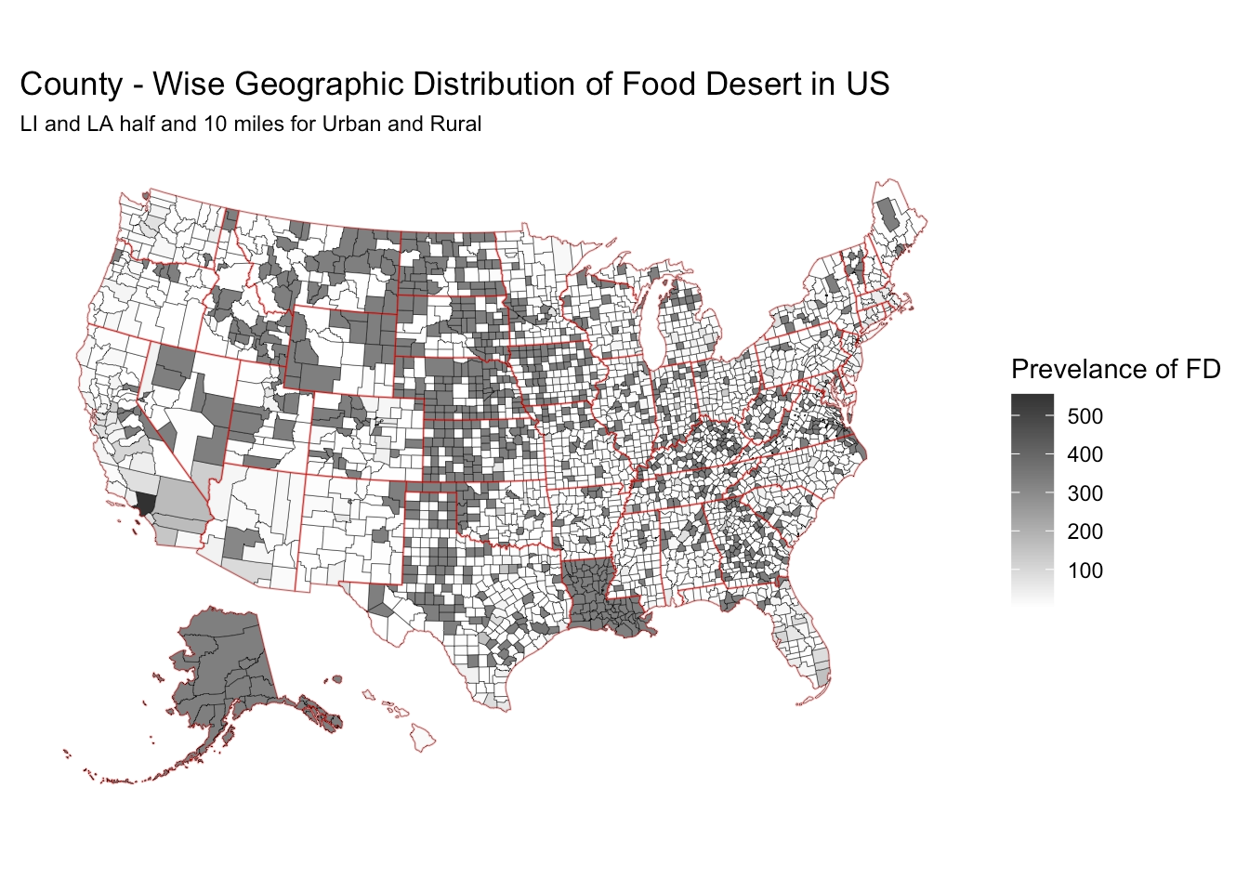
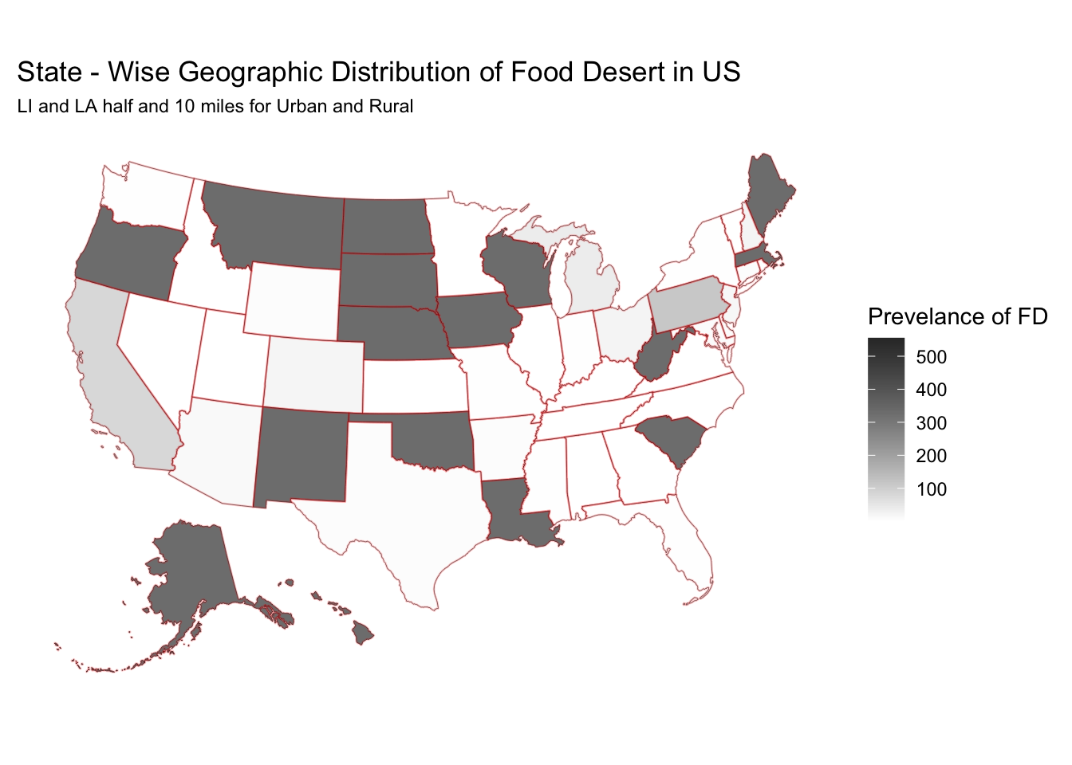
Geographic Distribution of Food Deserts

Slide 8
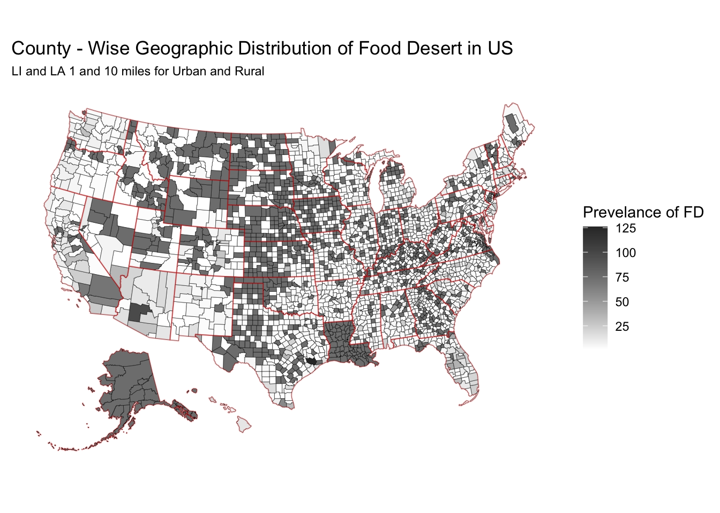
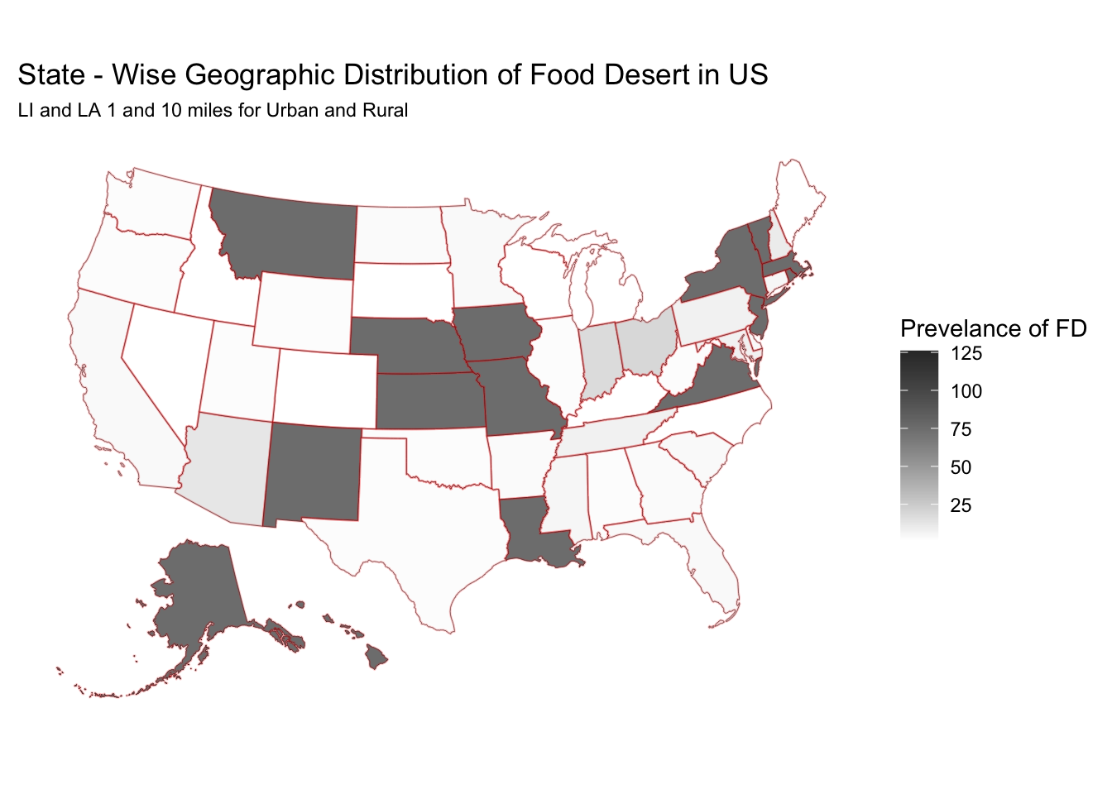
Geographic Distribution of Food Deserts

Slide 9
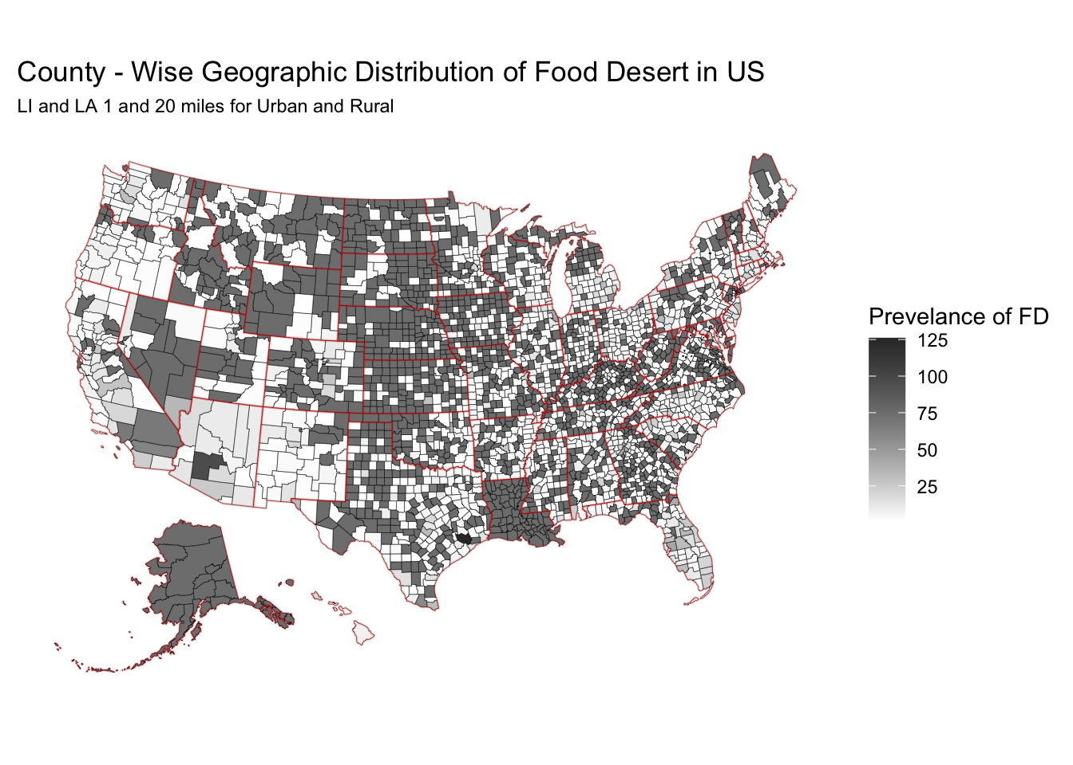
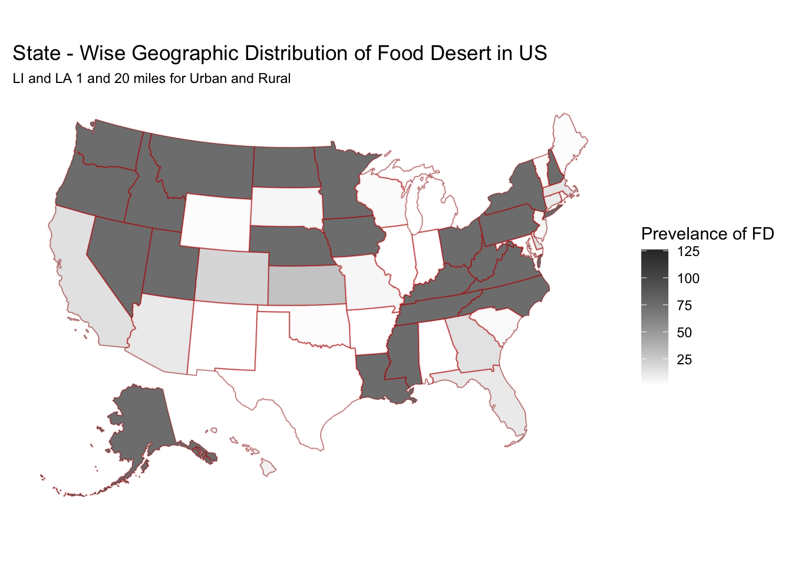
Geographic Distribution of Food Deserts

Slide 10
Urban vs Rural Classification impacts

Slide 11
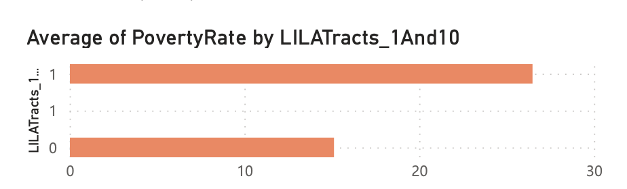
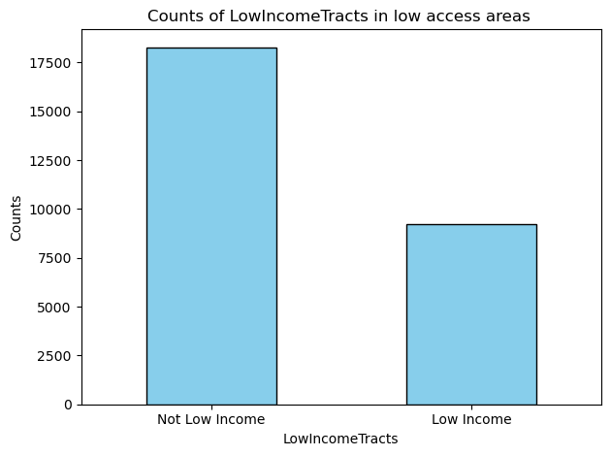
Correlation between poverty rate and Food desert
Poverty rate is high in food deserted areas
Poverty rate is 75% higher than non-food deserts
66% of the non-low income tracts are low access tracts
Low access people are rich which may mean rich people wants to stay outside.

Slide 12
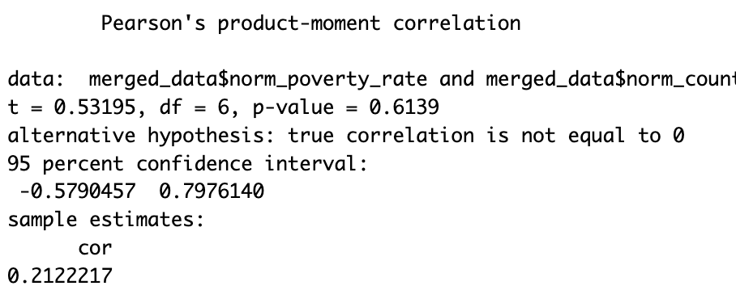
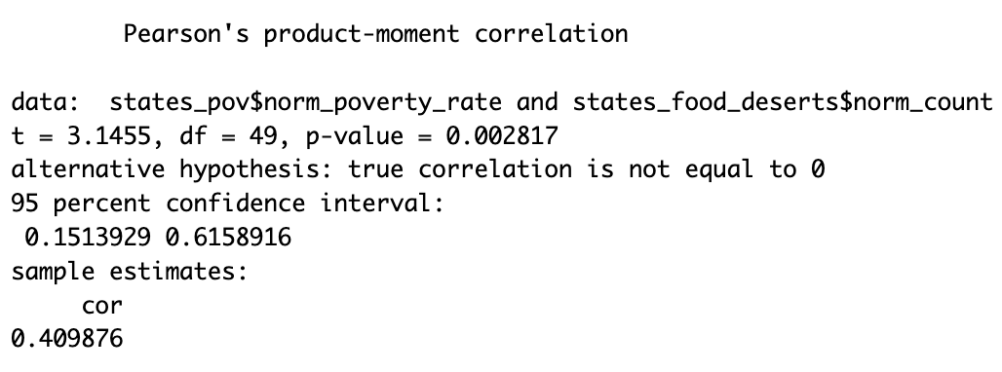
Correlation between poverty rate and Food deserts
No linear Correlation between High poverty rate states with count of their food desert
Correlation between poverty rate of all states with count of their food desert.

Slide 13
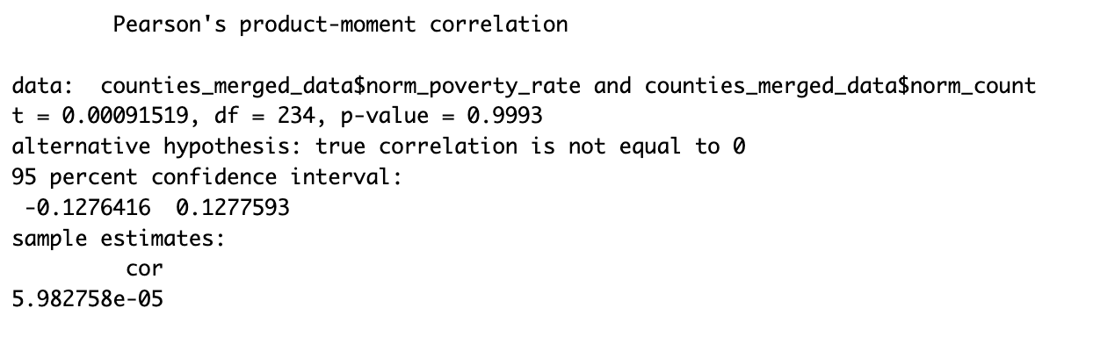
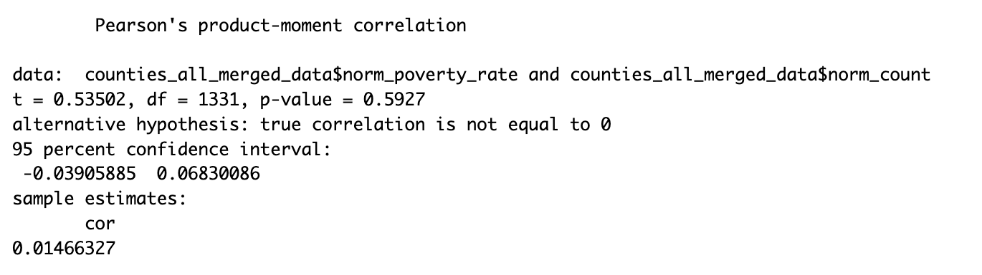
Correlation between poverty rate of counties and Food deserts
No linear Correlation between poverty rate of counties with count of their food desert.

Slide 14
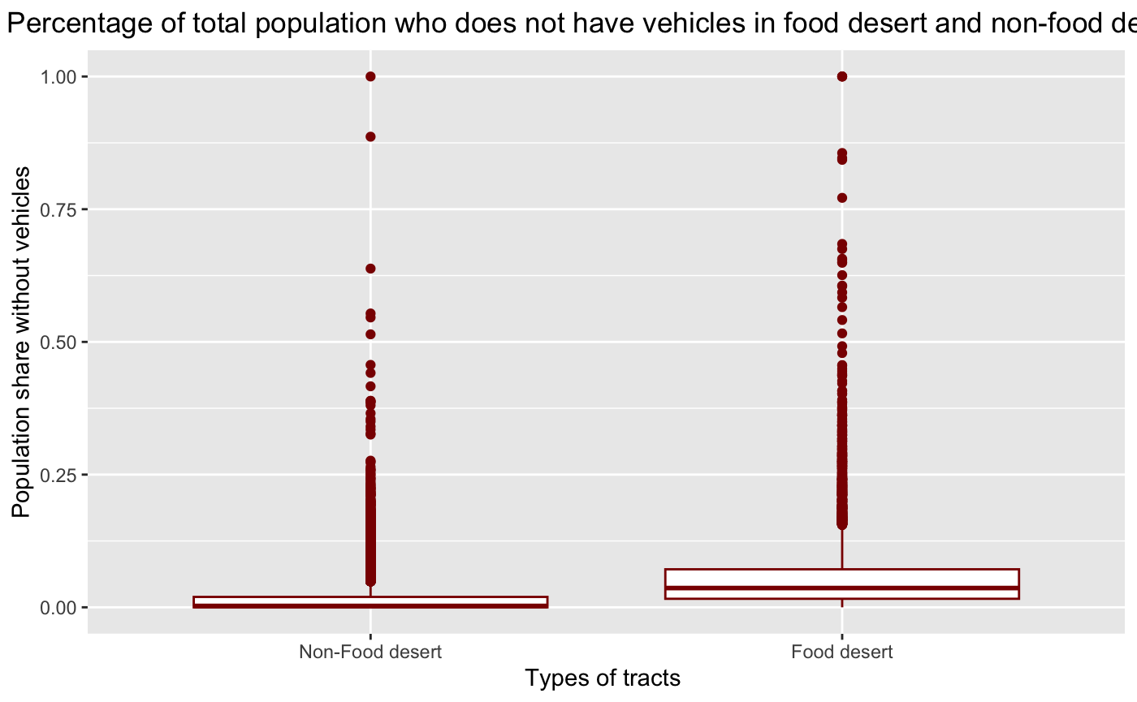
The impact of vehicle availability on food desert designation
A higher percentage of the population in food deserts lack vehicles compared to those in non-food
This could be concerning, as people in food deserts without vehicles may have even more difficulty accessing fresh and healthy food.

Slide 15
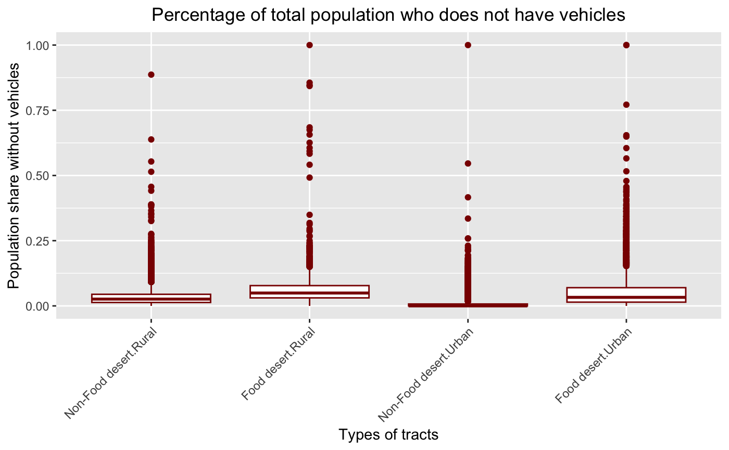
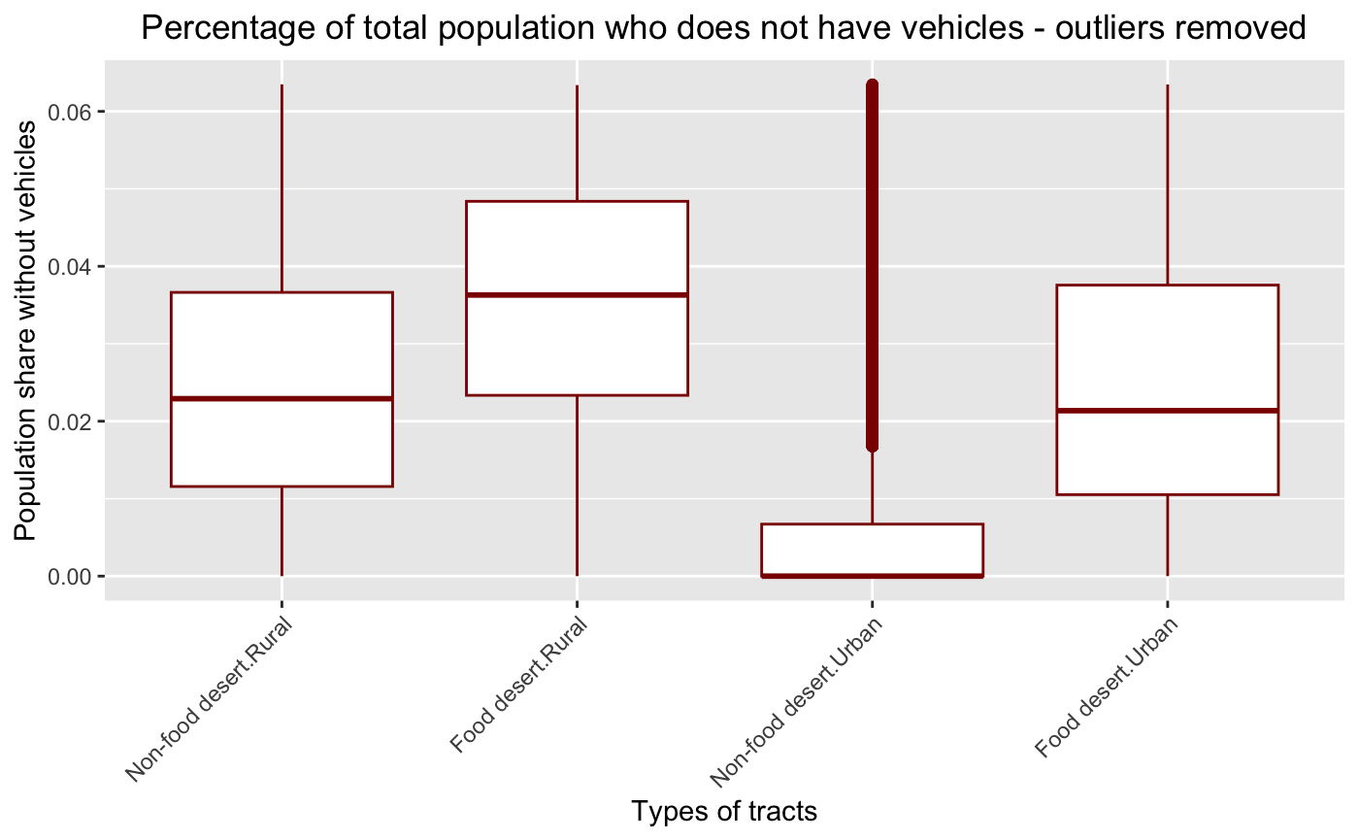
Vehicle access in rural and urban tracts
Food desert rural areas - lack vehicle access.
Non-Food desert urban – Highest vehicle access as expected
This highlights the impact of food desert status on transportation barriers, irrespective of the urban or rural context.

Slide 16
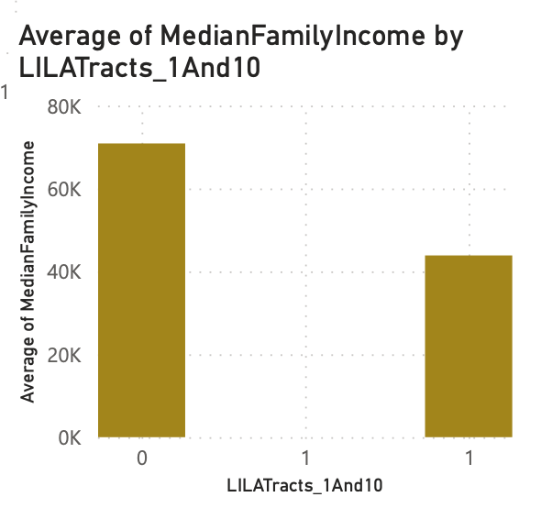
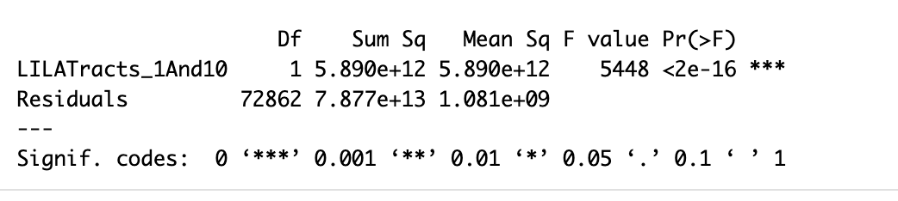
Food desert and Median Family Income
Anova on Median Family Income
The p-value 2e-16 is less than the 0.05. So, Reject the Null hypothesis
The Anova results tell us that there is statistically significant difference in median income among food desert and non - deserts

Slide 17
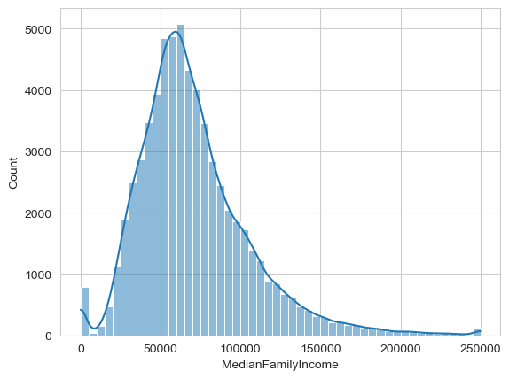
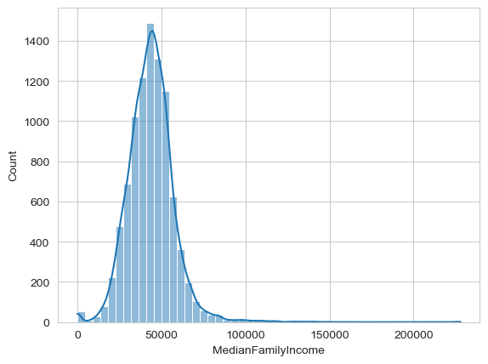
Relationship between Income variables
Median Family Income In Non-Food desert tracts
Median Family Income In Food desert tracts
Food desert – Low Income
Non-Food desert - High Income

Slide 18
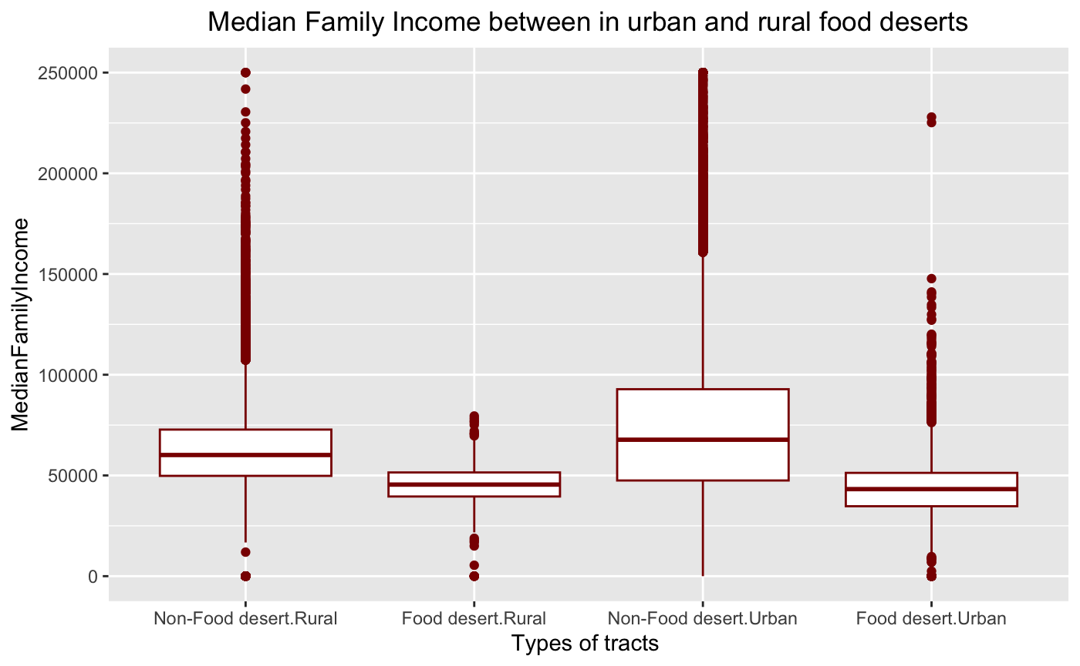
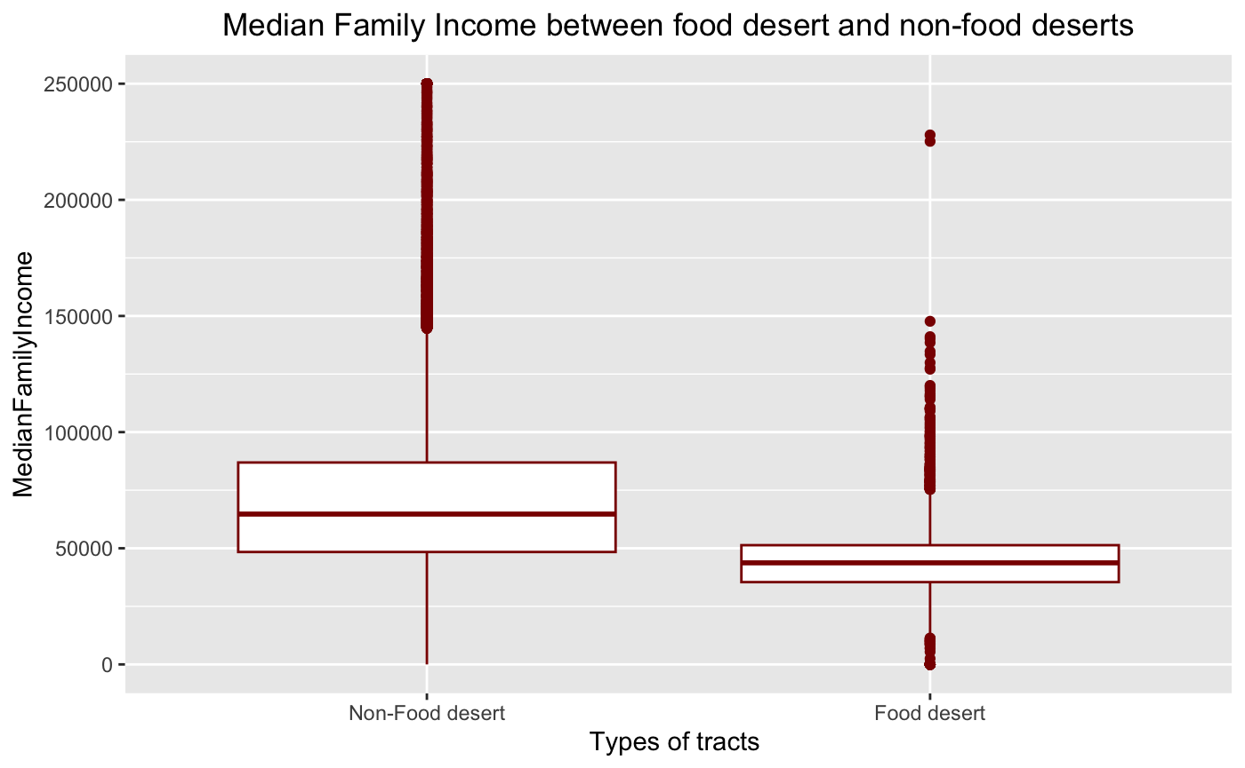
Median Family Income Distribution
95th level Confidence interval of mean for Food deserts
[43566.32 44127.11]
Mean estimate - 43846.72
95th level Confidence interval of mean for non- Food deserts
[70588.70 71129.46]
Mean estimate - 70859.08
The median family incomes in urban is almost similar to Rural
And non-food deserts in urban have higher median income than others.
This suggest that the food desert in the areas is not solely due to economic reasons

Slide 19
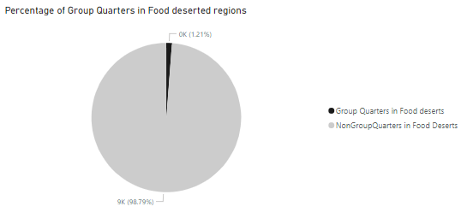
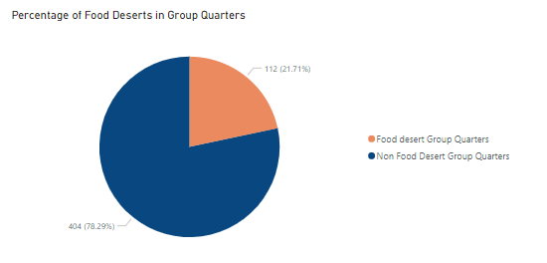
Characteristics of Areas with Group Quarters
Group Quarters are very less in Food deserted regions.
Also, Percentage of Food deserts in Group Quarters are less compared to Non Food deserts.

Slide 20
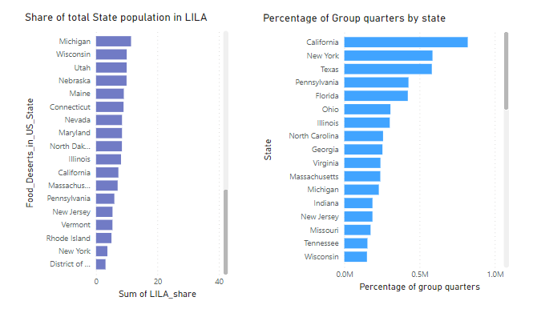
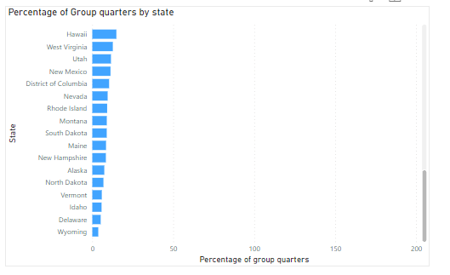
Percentage of Group Quarters tracts by States
California and New York have highest group quarters tracts.
Wyoming and Delaware have least group quarters tracts.

Slide 21
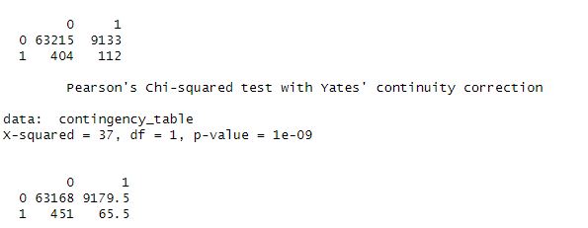
Correlation between Group quarters and the prevalence of Food deserts
Chi-square (GOF) between GroupQuartersFlag and LILATracts_1And10:
Null Hypothesis (H0): there is no association between the two categorical variables.
Alternative Hypothesis (H1): there is an association between the two categorical variables.
Significance level alpha = 0.05
Conclusion:
low p-value - reject the null hypothesis
thus there is a significant association or correlation between "GroupQuartersFlag" and "LILATracts_1And10."

Slide 22
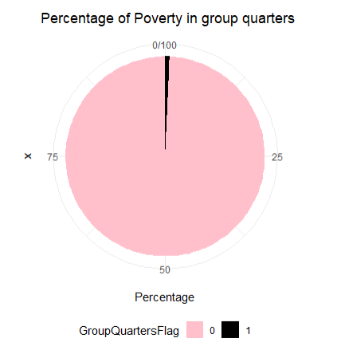
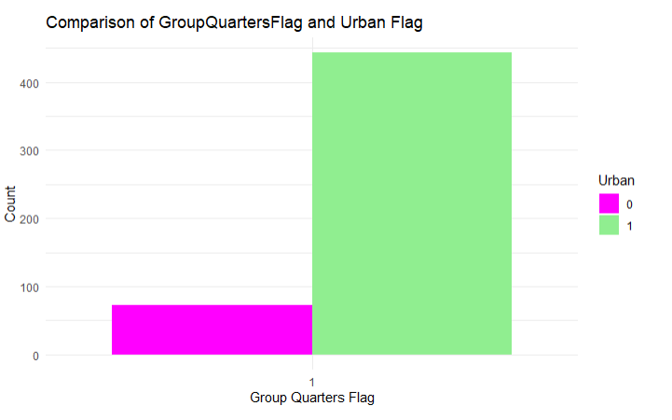
Characteristics of Areas with Group Quarters
Group quarters are more in urban compared to Rural.
Poverty rate is more in Non Group Quarters tracts.

Slide 23
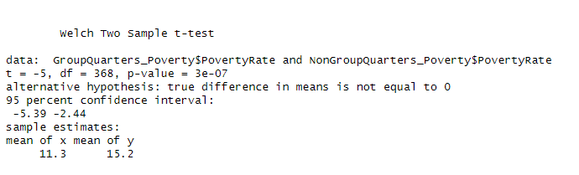
T-Test on "Poverty Rate" wrt Group quarters
Null Hypothesis (H0): The average Poverty rate are the same for with and without group quarters
Alternative Hypothesis (H1): The average Poverty rate are different for with and without group quarters .
Significance level alpha = 0.05
Conclusion :
There is a significant difference between the means.
Mean of Poverty rate is more in Non Group Quarters tracts.

Slide 24
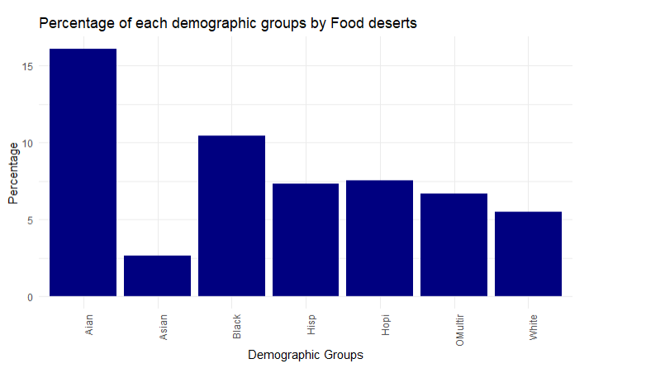
Demographic groups in Food Deserted Tracts
AIAN (American Indian or Alaska Native) and black are more in Food deserted areas compared to other groups.
Least Demographic group in Food deserts - Asian

Slide 25
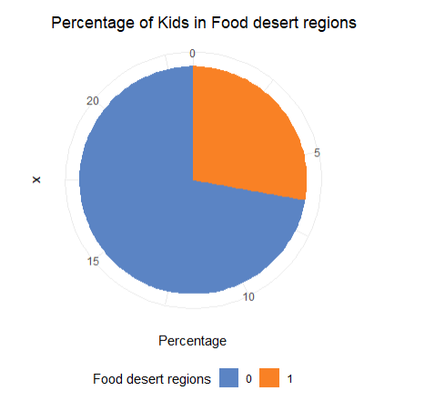
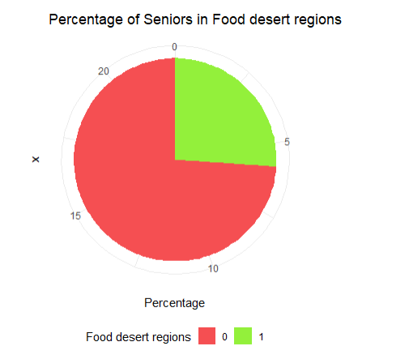
Age Distribution
Population of Kids and Seniors are more in Non Food deserted regions.
We can say, they opt for non food deserted tracts.

Slide 26
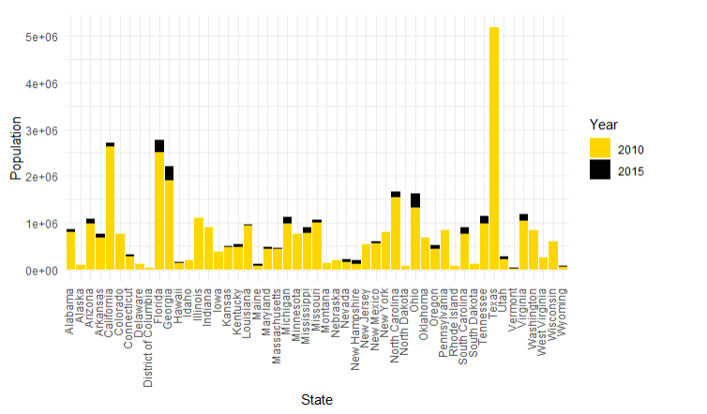
Population change in Food deserts from 2010 to 2015
In 2010, ~ 37 million of US population lived in Food deserted tracts
In 2015, ~ 39 million of US population lived in Food deserted tracts
Increased by 2M.

Slide 27
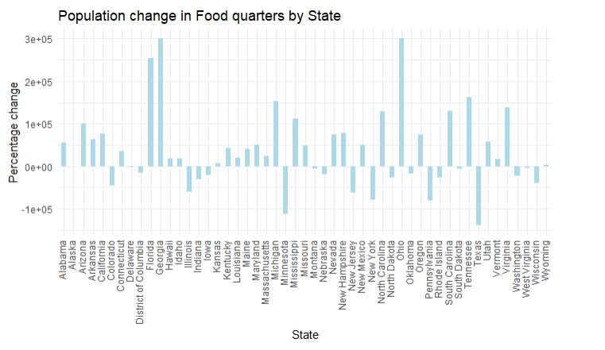
Population change in Food deserts from 2010 to 2015

Slide 28
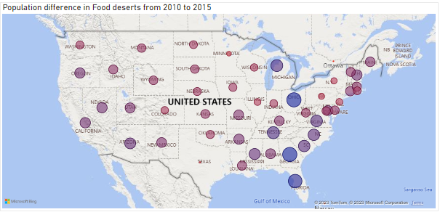
Population change in Food deserts from 2010 to 2015
High population difference
Low population difference
Eastern side states have major change in Food desert population.

Slide 29
Quantifying the extent of low access areas
Created a block of R code to filter-out the variable:
low income and low access tract measured at 1 mile for urban areas and 10 miles for rural areas (LILATracts_1And10 ) using the value, 1, to represent census tracts that had access and the value, 0, to represent census tracts that were not within the 1 mile to 10 miles range, non-access.
We also did the same methodology for access of low income and low access tract measured at 1 mile for urban areas and 20 miles for rural areas, LILATracts_1And20, as well as non-access.

Slide 30
Low Access Area Distribution
For the variable, LILATracts_1And10, we ran the R code to filter access and non-access for low income and low access tract measured at 1 mile for urban areas and 10 miles for rural areas .
The results were the following:
LILATracts_1And10
Percentage of access census tract in LILATracts_1And10 area = 12.7%
Percentage of non access census tract in LILATracts_1And10 area = 87.3%
LILATracts_1And20
Percentage of access census tract in LILATracts_1And20 area = 11.1%
Percentage of non access census tract in LILATracts_1And10 area = 88.9%

Slide 31
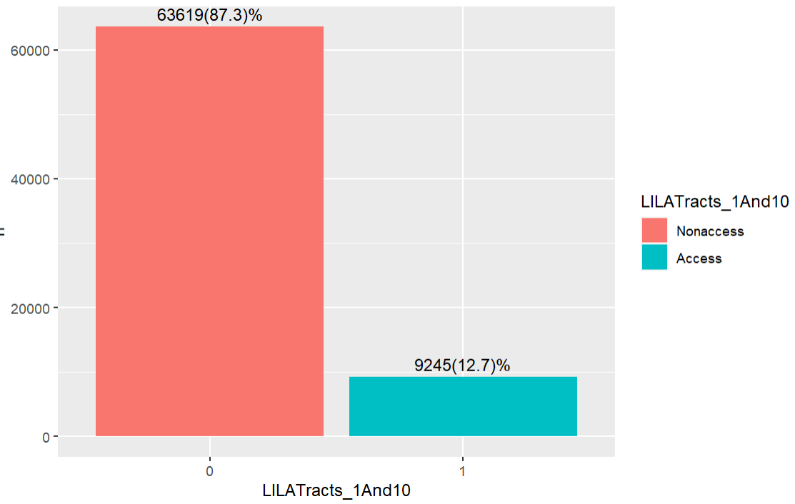
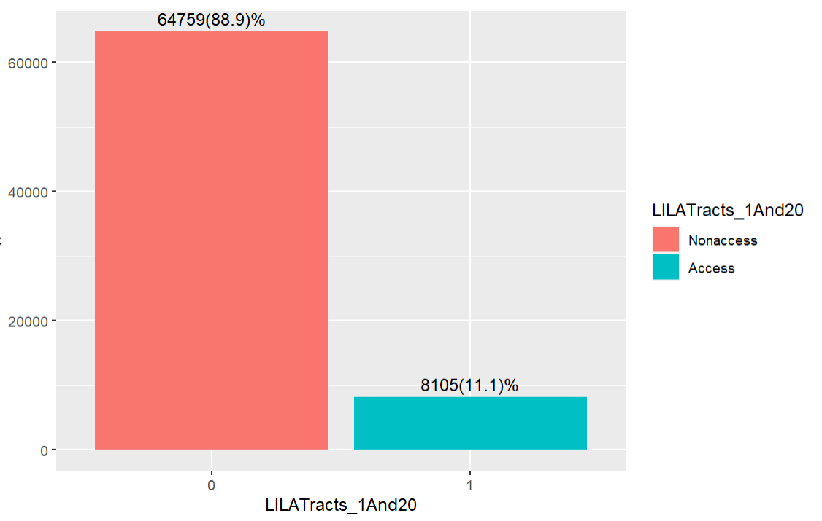
Patterns in the prevalence of food deserts

Slide 32
Identifying actionable insights
Government Policies
In order to eradicate food apartheid and create a food system where everyone has equitable access to fresh produce, vegetables, and other healthful foods, government regulations must now be a major factor (2023).
Supplemental Nutrition Assistance Program (SNAP)
Nongovernmental Food Assistance Programs
Maryland Food Bank (MFB)

Slide 33
Factors associating to the presence of food deserts
Some Factors for Food Deserts:
A Low Number of Food retailers
Major food retailers not only avoid opening locations in impoverished places, but they also frequently relocate their current locations to affluent neighborhoods (supermarket redlining).
High Levels of Unemployment
People who experience high unemployment rates are forced further into poverty and find it more difficult to pay for food and transportation.
Inadequate Access to Transportation
One of the main causes of food deserts (apartheid) is transportation where it is impractical for those without cars, those unable to pay for public transportation, and those with mobility impairments to frequently travel to the nearby supermarket or large grocery shop.

Slide 34
Targeted Areas
Mississippi had the greatest percentage of food deserts in the US as of 2015;
31% of its census tracts were categorized as low-income and low-access.
New Mexico and Arkansas came next, with 27 and 26 percent respectively, after Mississippi (FFAC Staff, 2022).
Other U.S. Locations
There is food apartheid in many areas of the nation, including:
Chicago, Los Angeles, New York City

Slide 35
Factors associating to the presence of food deserts
Community Gardens
Federal Resources for Low-Income Households
Potential Resolutions
Farmers’ Markets and Roadside Carts

Slide 36
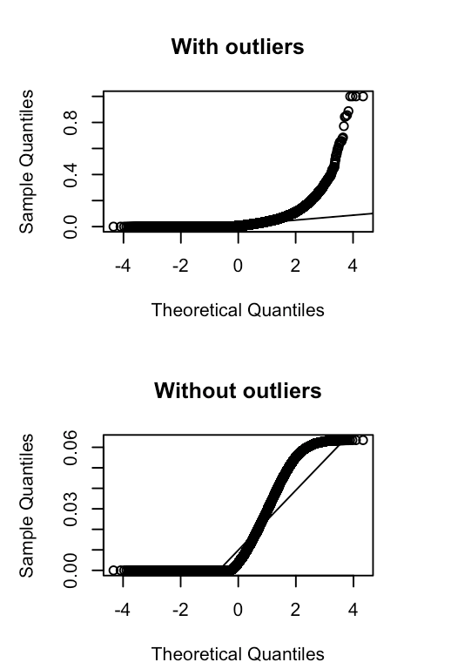
Analysis

Slide 37
References
Strengthen SNAP Benefits. (2023, October 13). Retrieved from https://frac.salsalabs.org/update-13october2023?eType=EmailBlastContent&eId=abd0e534-77e3-409c-957e-ae342b6d3f50
FFAC Staff. (2022, April 05). What Are Food Deserts and Why Do They Exist? Factory Farming Awareness Coalition. https://ffacoalition.org/articles/food-deserts/

Slide 38
Thank You!

